Slide 1
Jeopardy
(Web Dev Project-2) - HTML, CSS, and PHP

Slide 2
TOC
Team Members
Registration/Login
Play Game
Bug fixing
Highest Score Leaderboard
Use Case Diagram
Activity Diagram
Kanban Benefits
Limitations
Jeopardy Game Board
Score Counter(Increment/Decrement)
Questions Page
Logout Functionality
Obstacles
Main Game Code
Github Link

Slide 3
Team Members
Nolan Hinshaw - Programmer
Santiago Fleiderman- Designer
Christian Spencer - Tester
Jenny Dinh - Programmer
Nishant Datla - Programmer

Slide 4
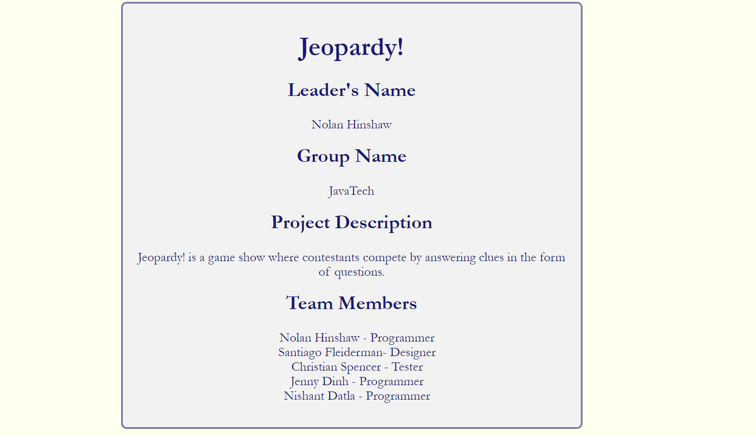

Slide 5
Overview/Objective of JavaTech’s Jeopardy
Users are required to register/login before playing
Security and logging concerns
Quiz based game where teams compete for money from various categories
Each category has difficulties (from 1-5) that have increasing money values
If you get the question correct, you gain money equivalent to the questions money value
If you get the question incorrect, you lose money equivalent to the questions money value
Goal: Accumulating as many points as possible and have more than the other team(s)!

Slide 6
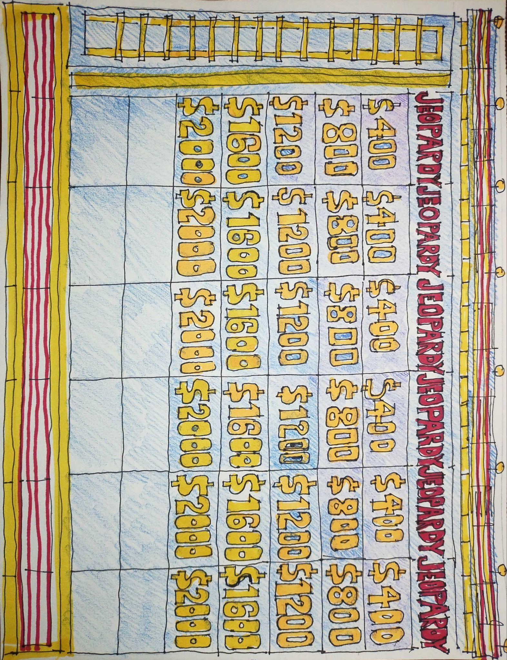
User Interface Sketch

Slide 7
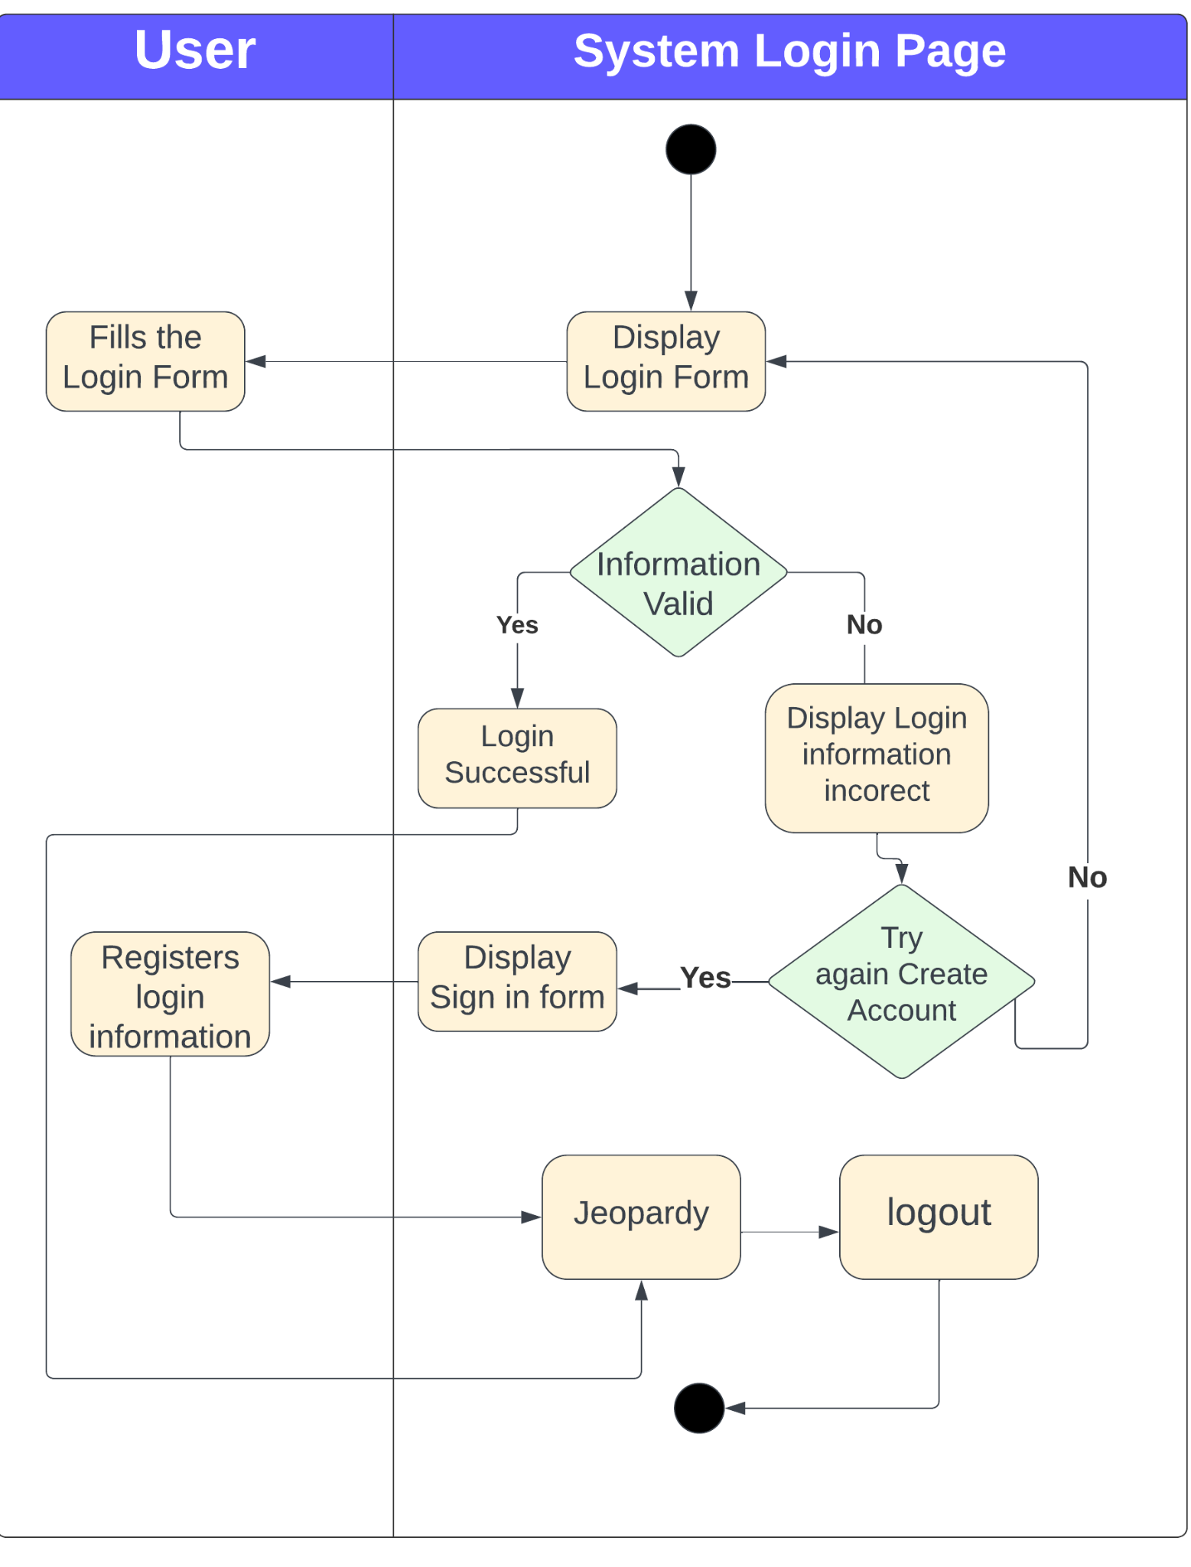
UML : Activity Diagram

Slide 8
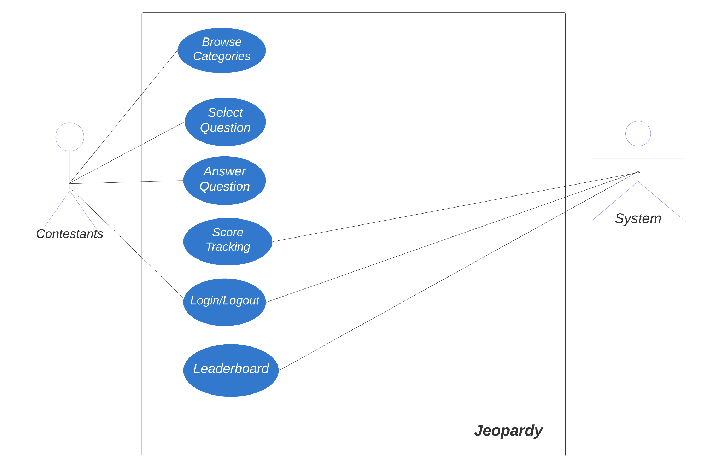
Use Case

Slide 9
Pages

Slide 10
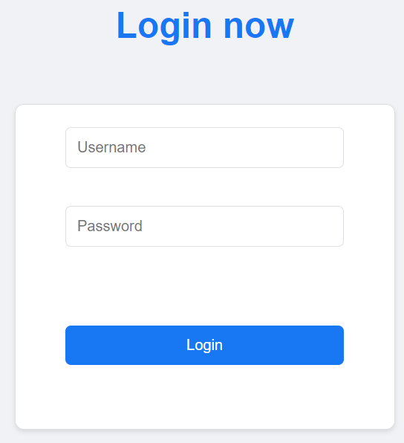
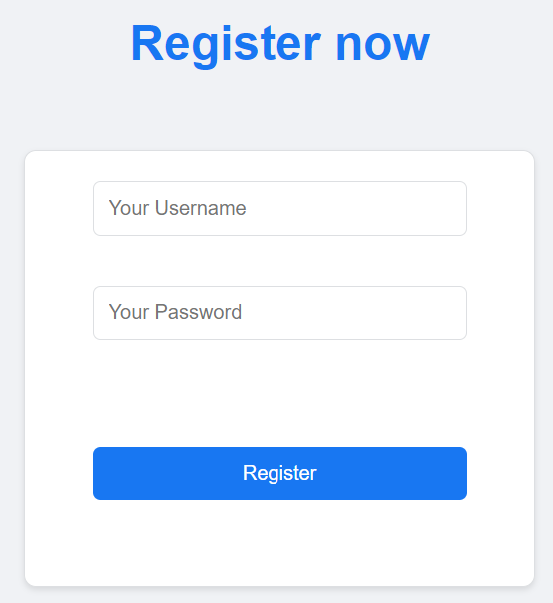
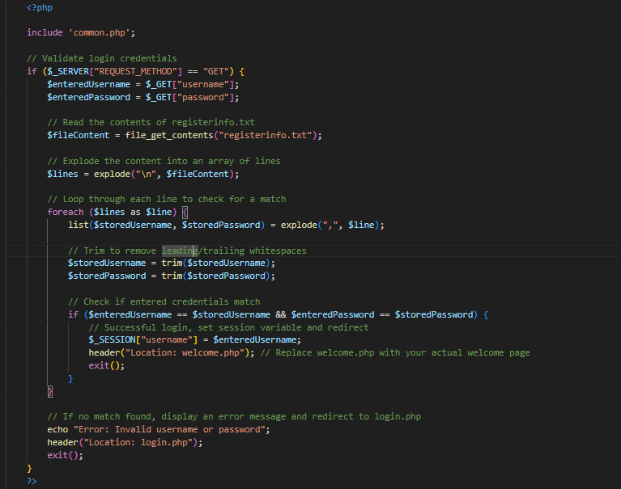
Registration/Login
Notes:
I am gonna talk here (nolan)

Slide 11
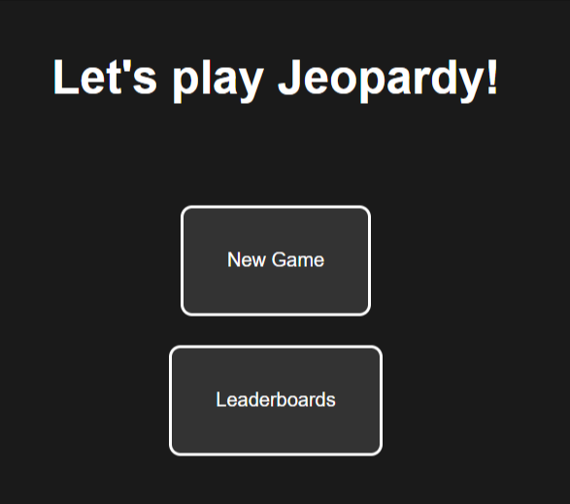
Play Game
Source Code:
Main function
Starts session in order to save scores
Main Functionalities:
New Game button
onClick => start game
Leaderboards button
onClick => view leaderboards
Notes:
nolan

Slide 12
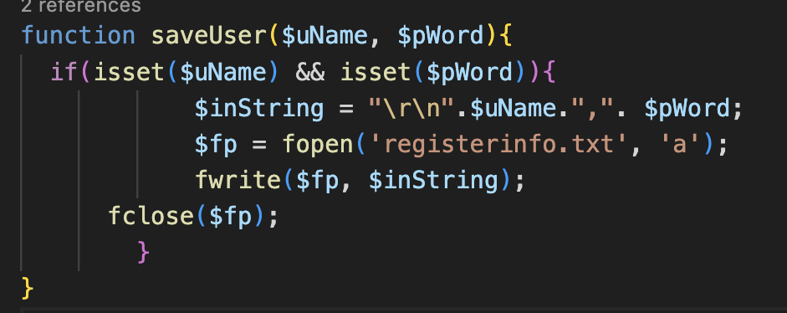
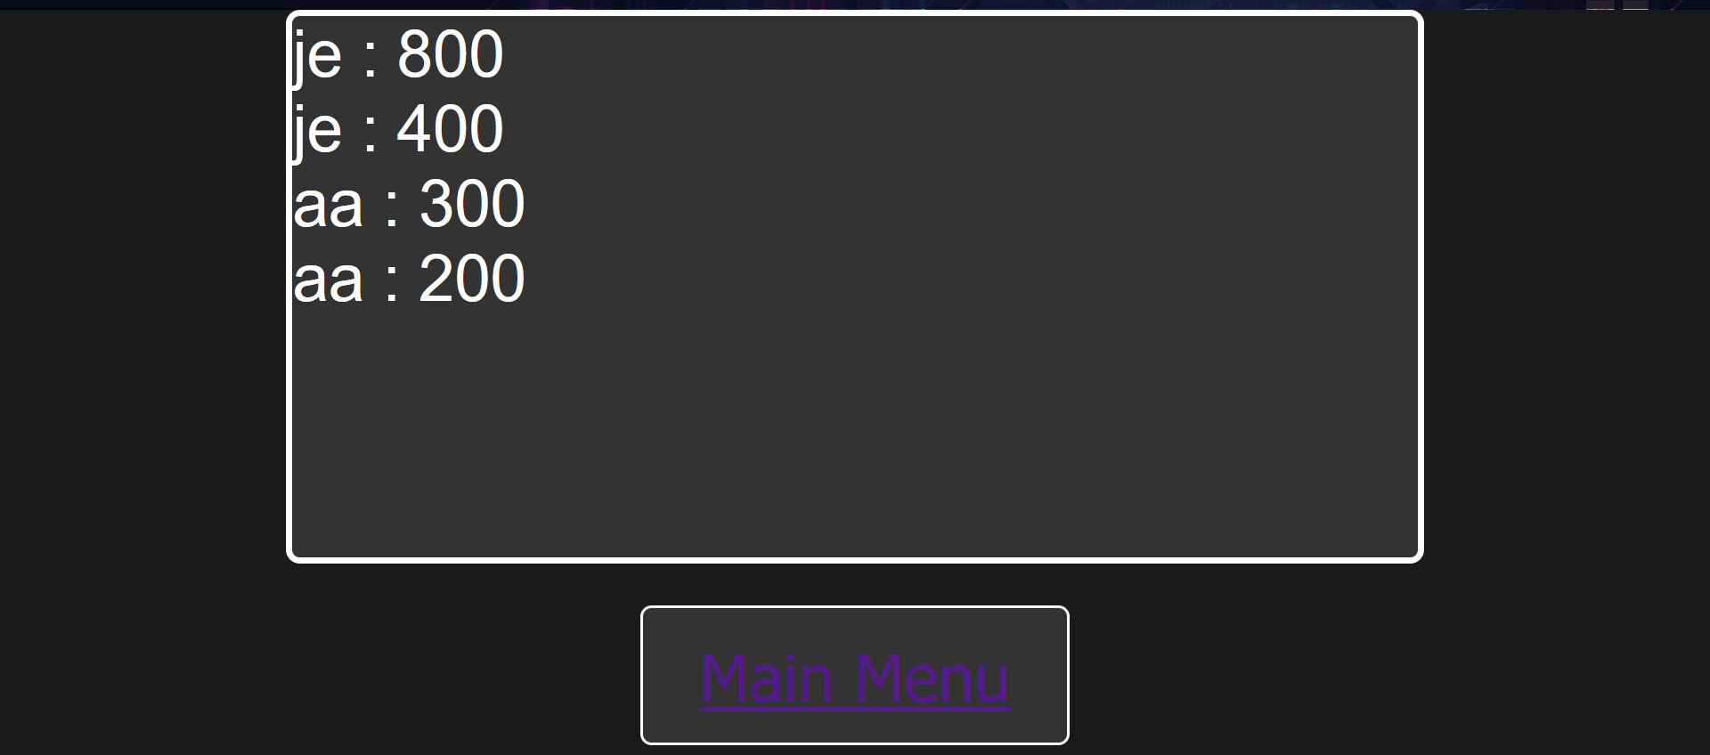
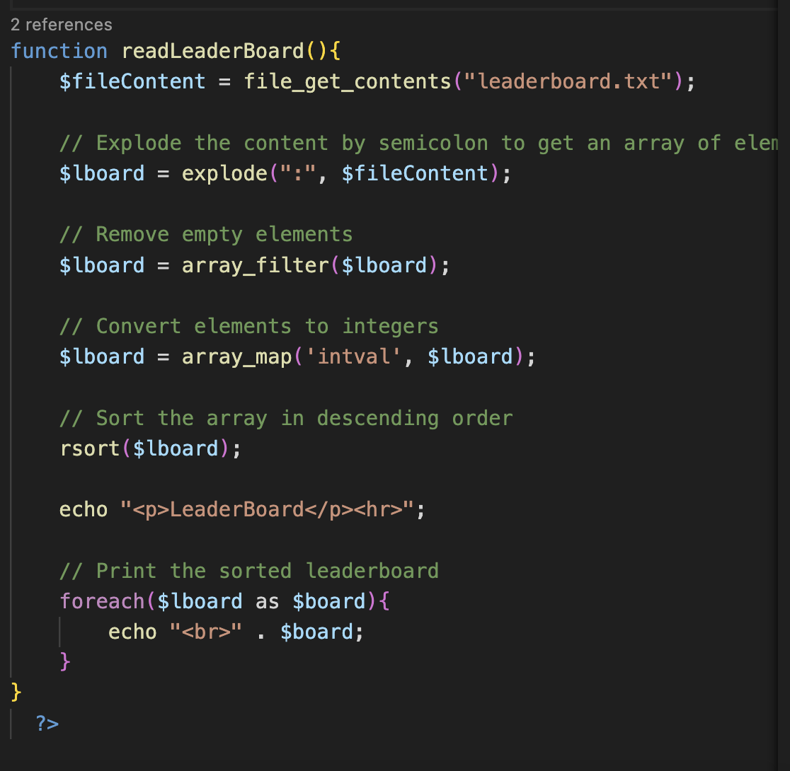
Highest Score Leaderboard

Slide 13
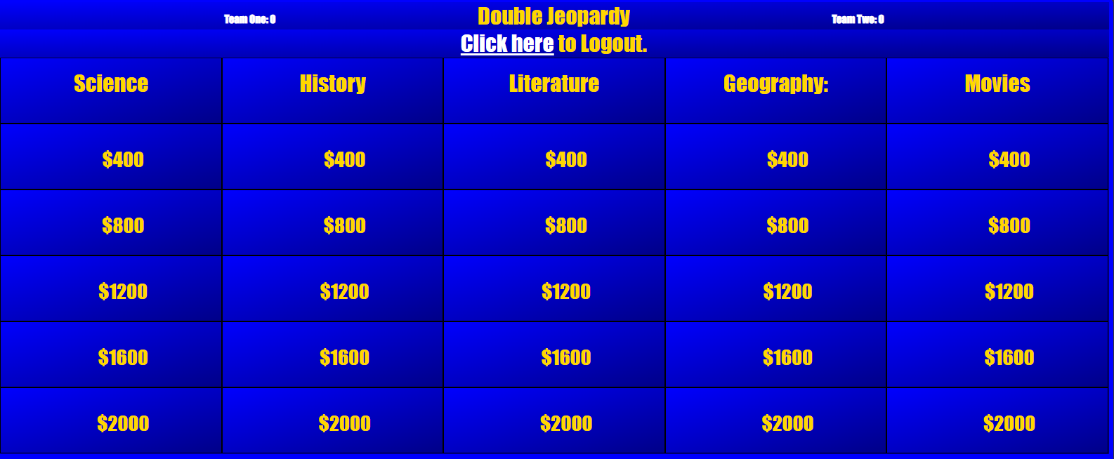
Jeopardy Game board

Slide 14
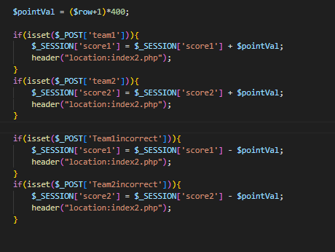
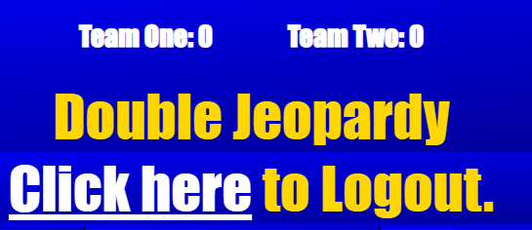
Score Counter(Increment/Decrementing
There are two teams and each with score counter. These score counters are updated depending on who gets the points based, which is changed based on the button (from the buttons on the previous page) that is pressed.
Notes:
Nishant

Slide 15
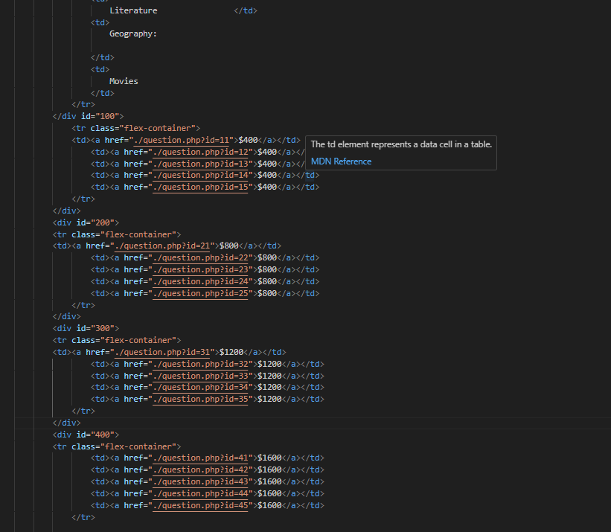
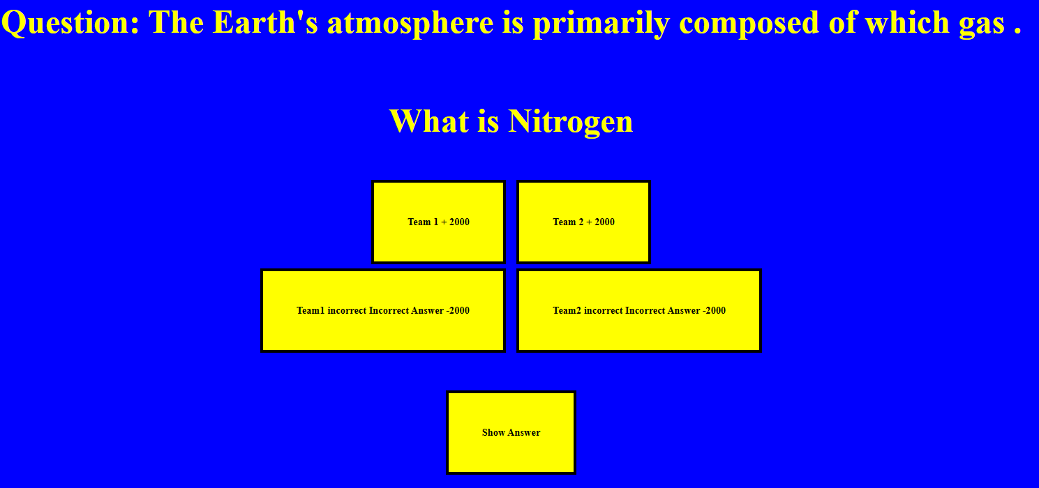
Question Page
Notes:
Christian/Jenny

Slide 16
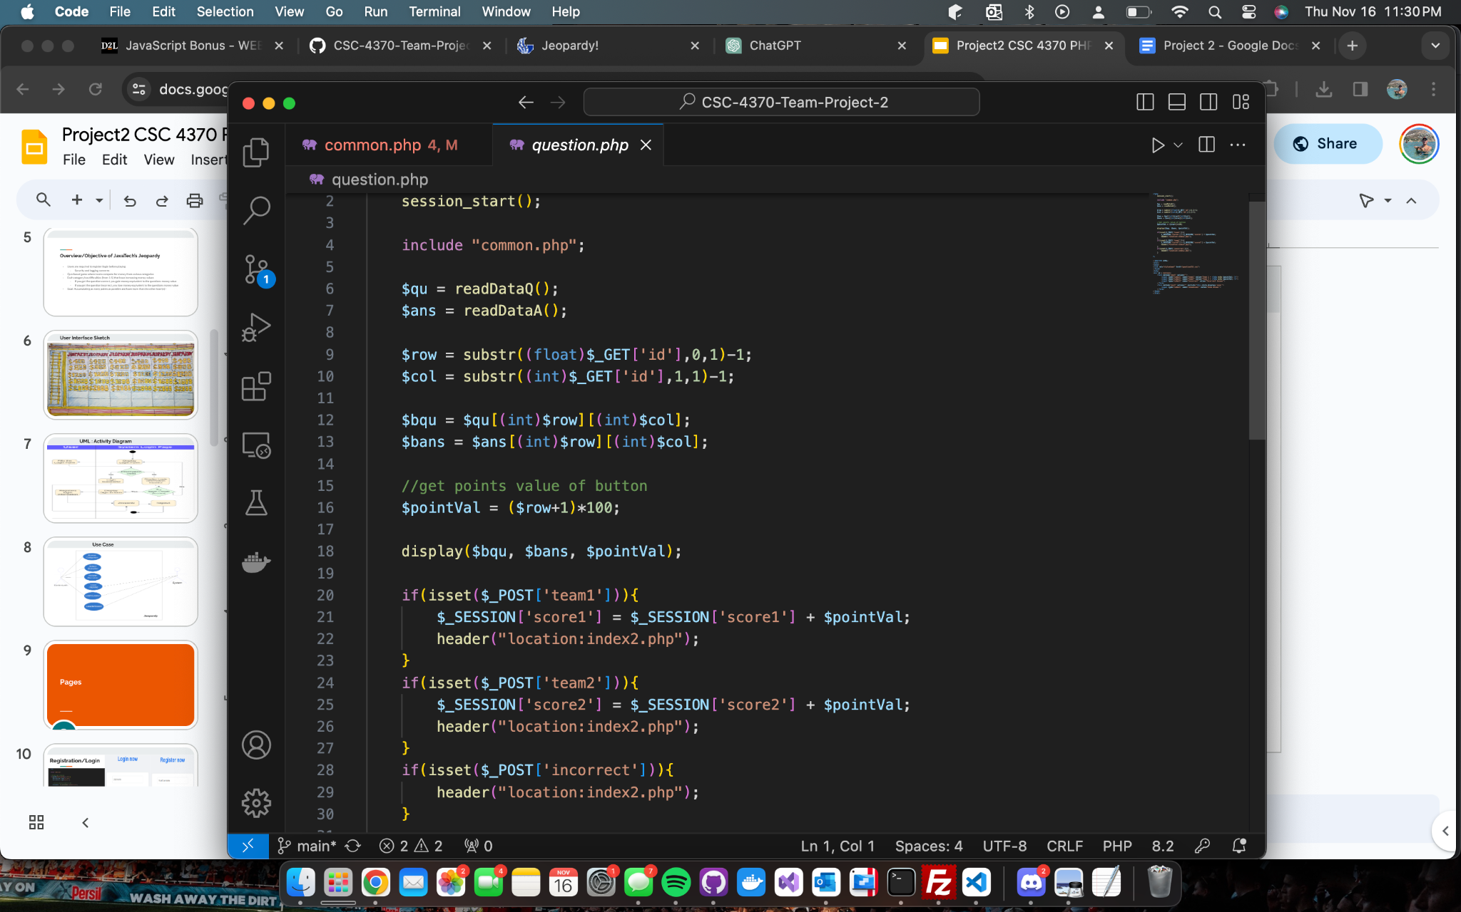

Slide 17
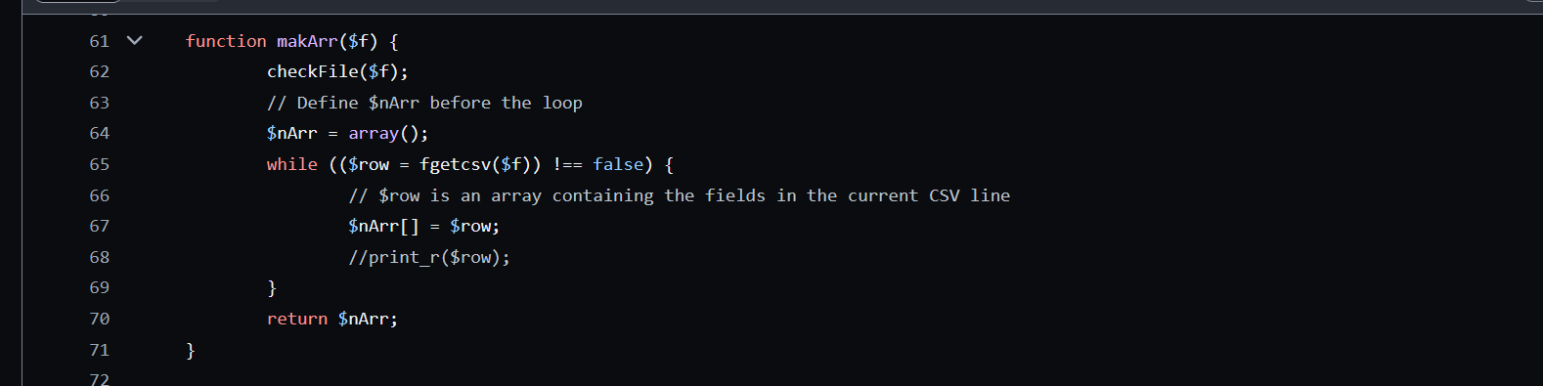
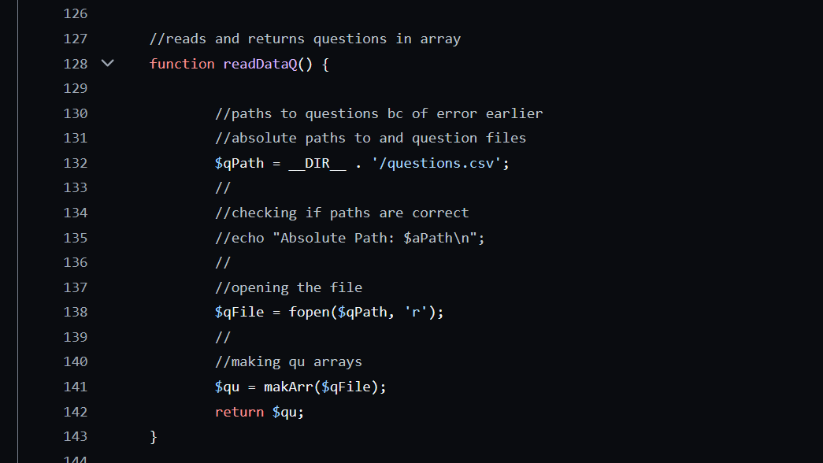
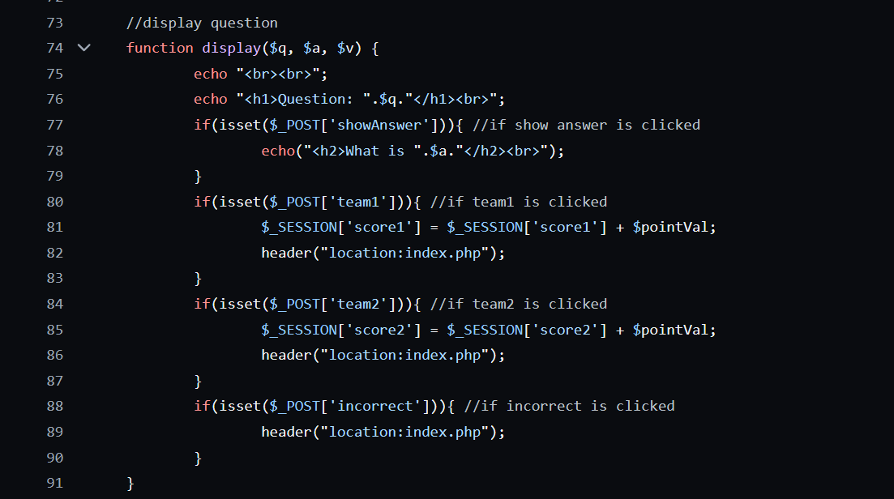

Slide 18
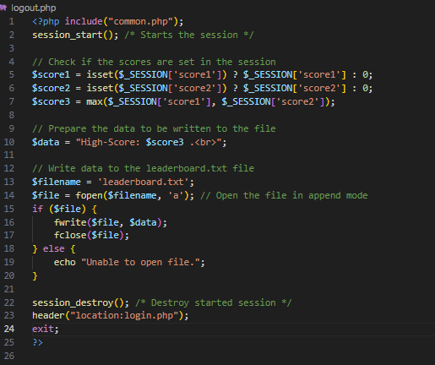
Logout Functionality
When user clicks the logout hyperlink it signs user out and stores the score of the winning team in a text file called leaderboard. This information is is pulled and sorted when the user checks leaderboard.

Slide 19
Obstacles
Incrementing or decrementing the score counter for two teams.
Registering new users; storing username and password onto a .txt file.
Generating Jeopardy board questions by employing PHP functions as the basis for inquiries.
Storing Jeopardy board answers from a .txt file into a multidimensional array.
Verifying login credentials, specifically the username and password, by referencing content from a .txt file. If no match found, redirect user to homepage.
Employing image alignment buttons with float properties in CSS (float: none|left|right|initial|inherit;).
Leaderboards logout records the highest score.

Slide 20
Demo

Slide 21
Kanban Benefits(Scrum)
1. Visual Management: Kanban uses visual boards or cards to represent tasks or work items, making it easy to see the status of work in progress. This visual representation helps teams understand workloads, identify bottlenecks, and maintain transparency.
2. Flexibility: Kanban is highly adaptable and can be implemented in various contexts, from manufacturing to project management. Teams can easily adjust and customize their Kanban boards to fit their specific needs.
3. Continuous Improvement: Kanban emphasizes the concept of continuous improvement. Teams regularly review their processes and make incremental changes to enhance efficiency and reduce waste. This iterative approach promotes a culture of ongoing improvement.
4. WIP Limitation: Kanban typically includes work-in-progress (WIP) limits, which restrict the number of tasks a team can work on simultaneously. This constraint helps prevent overloading and promotes Communication: Kanban encourages open communication within teams and across departments. Team members can see the status of tasks on the Kanban board, which promotes collaboration and keeps everyone informed.
Notes:
Santiago Perhaps?

Slide 22
Sprint Planning/Sprint Review
The Team discusses what went well during the Sprint, what problems it ran into, and how those problems were solved.
The Team demonstrates the work that it has completed and answers questions, if any, about the Increment. The entire group then discusses on what to do next. Thus, the Sprint Review provides valuable input to Sprint Planning of the subsequent Sprint.
Identify the major items that went well and potential improvements.

Slide 23
Youtube: https://www.youtube.com/watch?v=nt4BSnNsQmw
Demo: https://www.youtube.com/watch?v=1vcpWWhigss

Slide 24
Jeopardy: https://github.com/diocletian53/CSC-4370-Team-Project-2.git

Slide 25
Fin.

